Slide 1
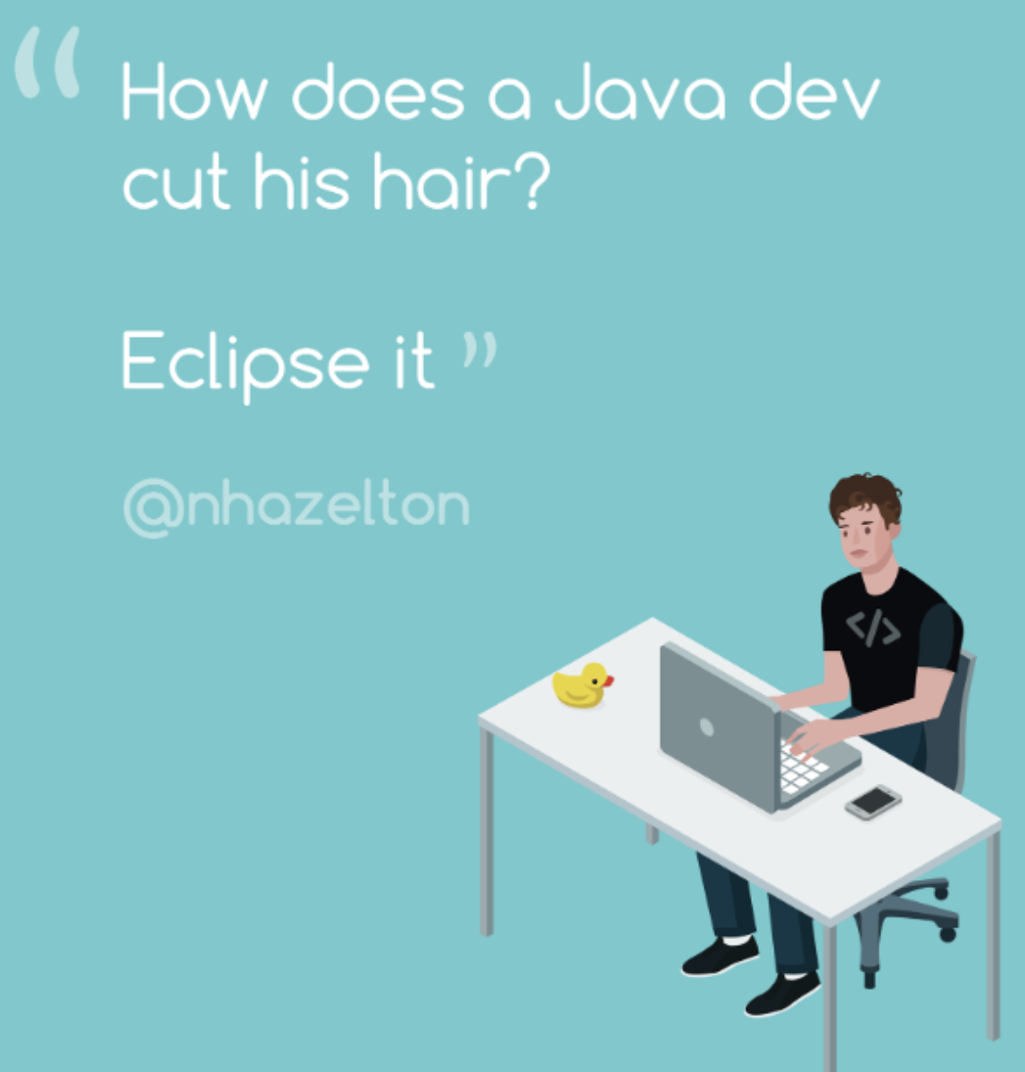
M01 L04 Software Development

Slide 2

Goals
Check in - any questions?
Book - 1. Getting Started and Primitive Types — CS Java - not creating a course since we have canvase
New Seats
Team Collaboration CS1050 Deb Harding | General | Microsoft Teams
Quiz Module 1 Feb 12th /13th - If you have accommodations for extra-time see me to plan taking the quiz.
Goals
Building a software solution to a problem
User Stories and Acceptance Criteria
Plan solution to a problem
Analyze Problem
Understand Preconditions and Postconditions for Testing
Design Algorithm
Implement small pieces of code, run, test and debug, commit and push
Technical Documentation
How do you create it?
Why do you create it?

Slide 3


Java Program Chat
How do software developers create software like the canvas MSU uses?
How does it calculate grades for different classes?
How is your grade calculated for this class?
How do you approach creating a program to calculate your final grade?
How do you know if it is working?
How do you make sure you made a quality solution following industry processes?
How do people in computer science careers remember all of this?

Slide 4
Problem Solving and Software Development
Approach problem solving using Agile Software Development concepts to help you design and implement a solution that is maintainable, testable and extendable.
You will
Analyze requirements and break the problem into smaller tasks
Create test cases
Design Algorithm
Create quality code
Unit test as you implement code
Complete final testing

Slide 5


Solution: Functional Completeness and Correctness
Goal
Functional completeness: Measures whether functionality is complete by satisfying all business requirements
Check to ensure includes all functionality user stories (requirements)
Functional correctness: Ensures whether functionality is accurate by satisfying acceptance criteria
Check to ensure all test cases will validate acceptance criteria

Slide 6
Step 1: Analyze Problem
User Story: A student needs a program to calculate their final grade using the category weights for Deb’s CS1050 so they do not need to do it manually and try different possible grades they might earn.
Acceptance Criteria:
Calculate final grade percentage accurately and displays to 2 decimal places according to syllabus.
Understand Problem: From the syllabus each category has a weighted percentage.
Discuss how your grade is calculated?
First Name | Last Name | Guided Exploration | Particip | Quiz | Project | Final Exam | Final Grade
 |  | 0.2 | 0.10 | 0.25 | 0.25 | 0.20
Firmware | Rebels | 95.00 | 92.00 | 87.00 | 93.00 | 85.00 | 90.2

Slide 7
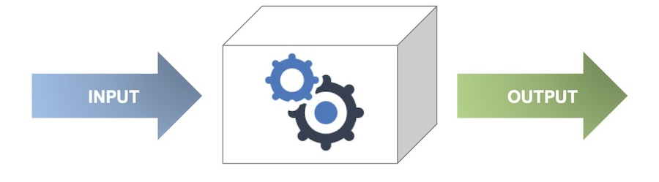
Step 2: Develop Test Cases
Goal of Agile Methodologies is to get fast feedback to make changes.
What is Test Driven Development (TDD)? and What is Unit Testing?
Create test cases for each task to ensure functional correctness. This helps to
design better algorithms
unit testing as you implement code
Functionally
preconditions
preconditions
Pre | Post
GE: Part: Quiz: Projects: Final: | Final Grade:
GE: Part: Quiz: Projects: Final: | Final Grade:
How would you test your program to calculate your final grade?
What are possible preconditions and postconditions?
Write down 2 different test cases for calculating your grade.

Slide 8


Design Algorithm in Pseudocode
Write down what you would do to calculate your grade and then how you would tell the computer to to calculate it for you.
What would variables and constants you would use?

Slide 9
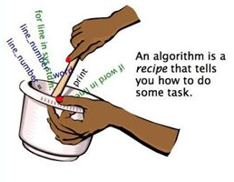

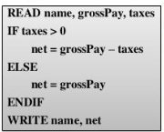
Design Algorithms with Pseudocode
Algorithm: a set of steps to complete a task
A set algorithm could be used to solve a problem.
Examples: Tie your shoe lace and Rubik’s Cube Algorithms
Pseudocode is the plain English representation of a computer algorithm, which specifies the flow and operation of the program.
Pseudocode is the bridge that connects what you want the program to do with code that the computer can understand.
Designing algorithms with pseudocode

Slide 10

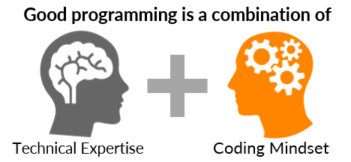
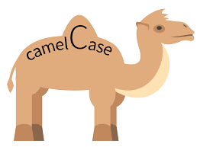
Coding Mindset and Quality Code
Read Coding Mindset.The expectation is to write code that uses consistent style that is easy to read and understand
Understandable and Readable Code
Naming conventions for identifiers
Variables - numberCylinders
constant - MAX_STUDENTS
Avoid hard coding data, for example use constants for
NUMBER_STUDENTS = 10
BEEF_TACO_PRICE = 4.59
Documenting with informative comments
Initial comment that describes what the program does
Comments that explain sections of code
Are you naming variables and constants appropriately?

Slide 11
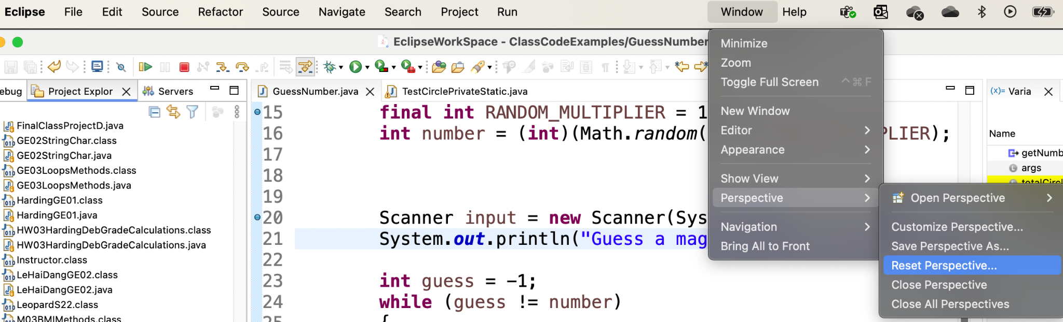
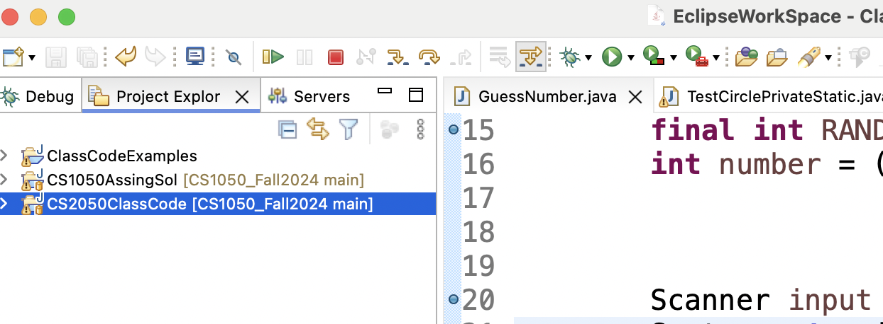
Eclipse
Reset perspective in eclipse if you lose your different windows.
Use projects to organize your code. You do not need to make a new project for every java file.
As you start writing your code. Write a few lines of code and run your program. Use the debugger to see each line and what is happening in memory.

Slide 12

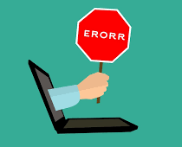
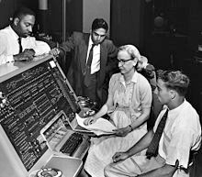
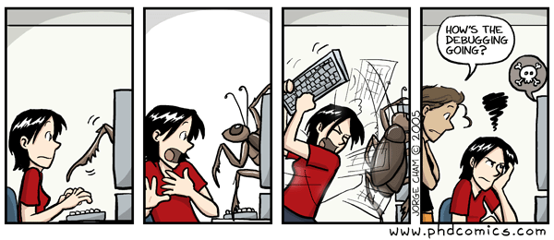
Debugging
When your find errors in the code, these are called bugs. Removing the bugs meaning fix the errors is called debugging.
Grace Hopper found the problem, a moth in the computer.

Slide 13
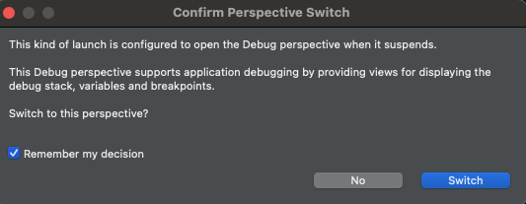
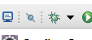
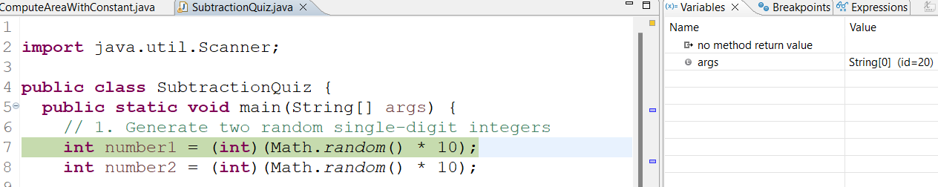
Debugging and Stepping Through Each Line of Code
Using the debugger is an important skill to help you not only fix bugs but understand what the code is doing. It allows you to step through each line of code and see what is being stored in the variables. Resources: Using Eclipse Debugger and Debugging in Eclipse Documentation
1. Double click next to the line number you want to pause to step through code
2. Click debug button and if asked switch to debug perspective check remember my decision
3. You will see the statement highlighted to show what statement you will start stepping through.
There should be a window to see the variables.

Slide 14


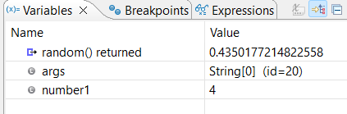
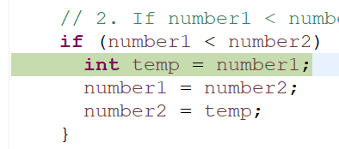
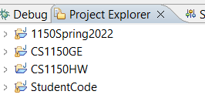
Debugging Part 2
4. Now you can step through program using step over
5. Notice what happens after you execute
6. A variable was create in memory and assigned 4.
7. Continue stepping until you get to the if statement to see the condition and what code runs. Run the program until number1 < number2 is true and notice the temp variable is created. Watch the variable window to see what happens when you exit the if block.
Can you explain?
You can toggle back to project explore and remove breakpoints.

Slide 15

Break

Slide 16
Technical Documentation
What Is a Developer Documentation & How to Create It?
Developer documentation provides details required for developers to effectively understand technologies and approaches to build computer artifacts.
Why Is It Important to Create Developer Documentation?
Eases Onboarding: Provides a roadmap for new developers, reducing time to understand software architecture and functionality.
Enhances Code Quality: Ensures high standards and consistency with clear guidelines.
Boosts Engagement: Encourages a vibrant developer community by enabling easier usage and extension of the product.
Reduces Support Costs: Helps developers solve problems independently with detailed resources.
Improves Reliability: Ensures compliance and reliability in critical industries through standardized documentation.
Supports Sustainability: Enables new team members to easily continue long-term project development.

Slide 17
Technical Documentation Tips
Each person in the group take a different Tip and read about it. Create a few bullet points in your document and then share with each other.
Be Concise When Writing
Avoid Using Technical Jargon
Be Sure to Include Code Snippets
Add Media to Your Documentation
Do you have information from a previous class on these concepts?
Have you ever used technical documentation to learn something?
Have you ever found documentation on github?
Have you ever created technical documentation on github?

Slide 18
Best Practices for Developer Documentation
Importance of Being Concise:
Developers need clear and precise answers.
Use short sentences, small paragraphs, and simple language.
Avoid unnecessary complexity to improve clarity.
Avoiding Technical Jargon:
Simplify writing to ensure accessibility.
Use standard industry terms if technical language is necessary.
Using Code Snippets:
Show what the product can do with practical examples.
Elevates documentation quality by catering to developer familiarity with code.
Role of Visuals:
Screenshots, GIFs, and videos enhance engagement and understanding.
Visuals simplify complex processes and reduce lengthy explanations.

Slide 19
Technical Documentation
The purpose of developer documentation is to provide developers with the instructions and information they need to build software solutions on different technologies, languages and methodologies (practices, procedures, and rules used).
Organize use headings and subheadings
Summarize, list, screenshots
Links to resources
Copy code snippets with comments in your code explaining
Link to code examples in your repository
Other resources such as websites and videos. Just remember not all information is good information.
Open: Technical Documentation Template CS1050 - Make a copy or download as word if you haven’t yet.
Review lectures, guided exploration and book. Add code examples, images, summaries and links to resources for module 1 concepts. This will help you prepare for the quiz.

Slide 20
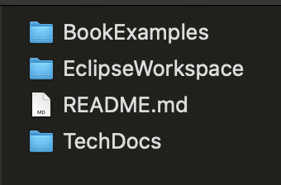
Preparation
Go today’s lecture module.
You will be doing this in the guided exploration and I provided this Technical Documentation Template CS1050
Organize your information
Participation - Upload technical documentation showing what you added in class
Guided Exploration
Quiz Feb 12th /13th ( See me to schedule if you have accommodations for extra-time)
40 Minutes and On paper
Questions: Multiple choice, true/false, fill in the blank
Write code and explain code
What goes in here?

